Slide 1
OohReader
Misha Nikonov
Yurii Rebryk

Slide 2
Idea
To create an application for convenient and productive learning English.

Slide 3
No competitors!

Slide 4
Technology
Learn unknown words
Look throw the text
Read the text

Slide 5
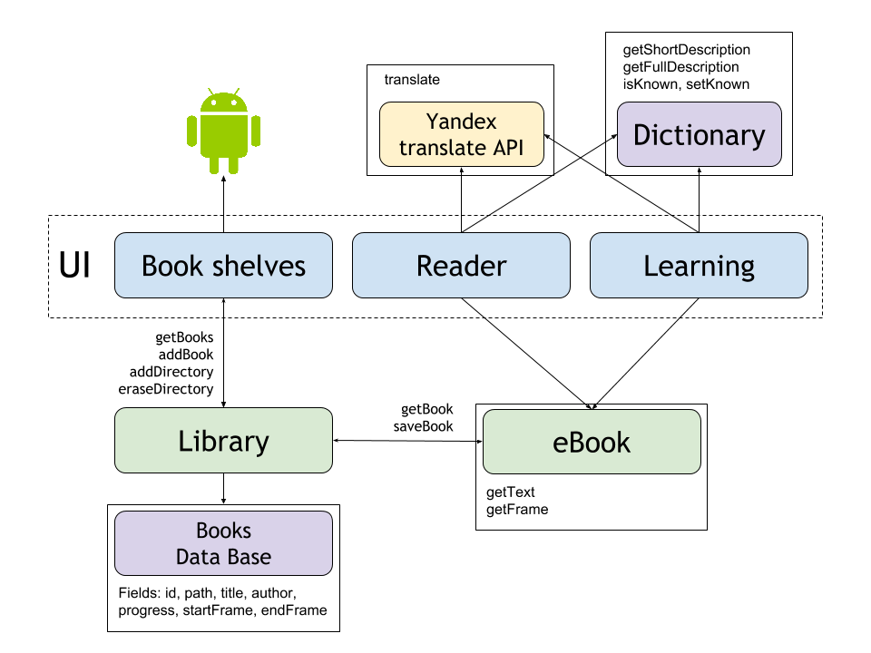
Architecture

Slide 6
Features
Offline glossary
Online Yandex translate
Smart words scanner
Amazing studying technology
Modern material design

Slide 7
Project
Contacts
https://github.com/Karma-Police/english-reader
https://github.com/Karma-Police
https://github.com/Rebryk

Slide 8
Show time!

Slide 9
Achievements
We’ve pushed over 506 922 lines of code.

Slide 10
New Year Sale!
84$
Save up to 50%!
42$

